Slide 1
Welcome to Quiz 5
Your target is to achieve 20,000 pts

Slide 2
Flowers
In this first round you have to identify 20 flowers. The good news is that they are in alphabetical order. There are 50 points available for each flower correctly identified.
Your target for this round is 800 points.

Slide 3
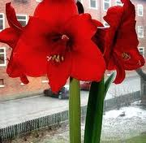
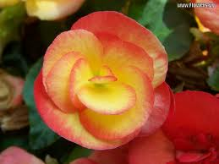
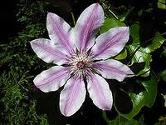
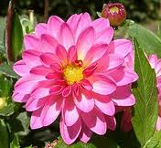
How many flowers can you identify? 50 pts for each.
1 | 2
3 | 4

Slide 4
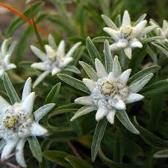
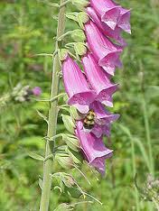
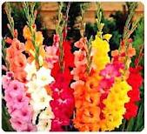
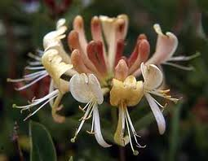
How many flowers can you identify? 50 pts for each
5 | 6
7 | 8

Slide 5
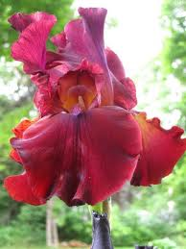
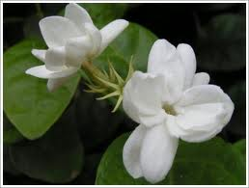
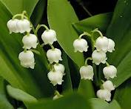
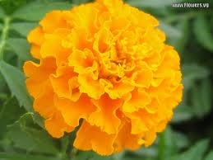
How many flowers can you identify? 50 pts for each
9 | 10
11 | 12

Slide 6
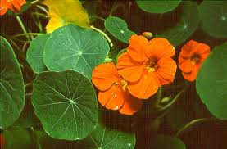
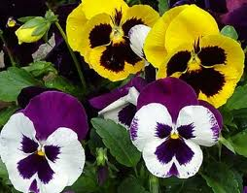
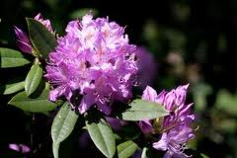
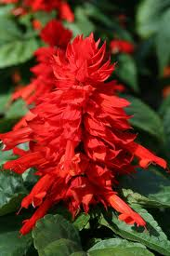
How many flowers can you identify? 50 pts for each
13 | 14
15 | 16

Slide 7
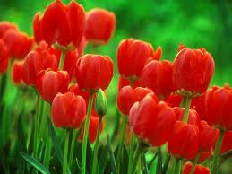
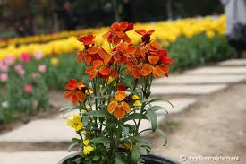
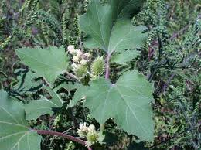
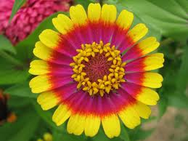
How many flowers can you identify? 50 pts for each
17 | 18
19 | 20

Slide 8
Answers
Have you tried all 20?
The answers are on the next page.
Good luck.

Slide 9
Flowers 50 pts each
1 | Amaryllis | 11 | Lily of the valley
2 | Begonia | 12 | Marigold
3 | Clematis | 13 | Nasturtium
4 | Dahlia | 14 | Pansy
5 | Eidelweiss | 15 | Rhododendron
6 | Foxglove | 16 | Salvia
7 | Gladiolus | 17 | Tulip
8 | Honeysuckle | 18 | Wallflower
9 | Iris | 19 | Xanthium
10 | Jasmine | 20 | Zinnia

Slide 10
Target
Did you achieve, or even surpass, the target of 800 points?
There are 9 questions in the next round. For each question you should choose one of the answers and can bet up to half the points you own at that point. If you are correct you win those points, but choose incorrectly and you lose those points.
Your target by the end of these 9 questions is 1800 points.

Slide 11
Today a gallon of petrol costs £6, but what was the price in 1970?
A | 5p
B | 10p
C | 20p
D | 30p
E | 40p

Slide 12
Today a gallon of petrol costs £6, but what was the price in 1970?
A | 5p
B | 10p
C | 20p
D | 30p
E | 40p

Slide 13
How many Football League clubs have ‘HAM’ within their name?
A | 9
B | 10
C | 11
D | 12
E | 13

Slide 14
How many Football League clubs have ‘HAM’ within their name?
Tottenham Hotspur , Wolverhampton Wanderers, Southampton, Birmingham City, West Ham United, Nottingham Forest, Oldham Athletic, Cheltenham Town, Fulham, Gillingham, Rotherham United, Northampton Town, Dagenham & Redbridge
A | 9
B | 10
C | 11
D | 12
E | 13

Slide 15
If these ladies were placed in order of their age, who would be in the middle?
A | Princess Beatrice
B | Duchess of Cambridge
C | Pippa Middleton
D | Britney Spears
E | Princess Eugenie

Slide 16
If these ladies were placed in age order, who would be in the middle?
A | Princess Beatrice 8/8/1988
B | Duchess of Cambridge 9/1/1982
C | Pippa Middleton 6/9/1983
D | Britney Spears 2/12/1981
E | Princess Eugenie 23/3/1990

Slide 17
Which hymn was voted the nation’s favourite by Songs of Praise?
A | Dear Lord and Father of Mankind
B | How Great Thou Art
C | Love divine all Loves excelling
D | The Day Thou Gavest Lord has ended
E | Guide me, O Thou Great Redeemer

Slide 18
Which hymn was voted the nation’s favourite by Songs of Praise?
A | Dear Lord and Father of Mankind
B | How Great Thou Art
C | Love divine all Loves excelling
D | The Day Thou Gavest Lord has ended
E | Guide me, O Thou Great Redeemer

Slide 19
Not counting the initial set of balls, in a Wimbledon Womens singles match, how many actual ball changes were there in a game which finished 6-2 6-1 7-6?
A | 2
B | 3
C | 4
D | 5
E | 6

Slide 20
Not counting the initial set of balls, in a Wimbledon Womens singles match, how many actual ball changes were there in a game which finished 6-2 6-1 7-6?
A | 2
B | 3
C | 4
D | 5
E | 6

Slide 21
How many of these celebrities real names are correct? Cliff Richard Harry Webb Tom Jones Tom Jones Mick Jagger Mick Jagger Engelbert Humperdinck Arnold Dorsey John Wayne Marion Morrison
A | 1
B | 2
C | 3
D | 4
E | 5

Slide 22
How many of these celebrities real names are correct? Cliff Richard Harry Webb Tom Jones Tom Jones (Thomas Woodward) Mick Jagger Mick Jagger Engelbert Humperdinck Arnold Dorsey John Wayne Marion Morrison
A | 1
B | 2
C | 3
D | 4
E | 5

Slide 23
Which of these is not a city?
A | Peterborough
B | Plymouth
C | Poole
D | Portsmouth
E | Preston

Slide 24
Which of these is not a city?
A | Peterborough
B | Plymouth
C | Poole
D | Portsmouth
E | Preston

Slide 25
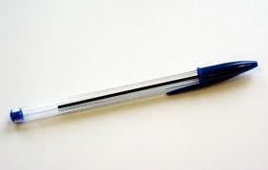
Who invented the writing implement shown opposite?
A | Sean Penn
B | Laszlo Biro
C | Dick Bic
D | Louis Biro
E | Spiro Biro

Slide 26
Who invented the writing implement shown opposite?
A | Sean Penn
B | Laszlo Biro
C | Dick Bic
D | Louis Biro
E | Spiro Biro

Slide 27
In 1934 the 57 Heinz varieties were listed? Which was not amongst them?
***************
A | Mock Turtle Soup
B | Carrot Soup
C | Oyster Soup
D | Celery Soup
E | Asparagus Soup

Slide 28
In 1934 the 57 Heinz varieties were listed? Which was not amongst them?
A | Mock Turtle Soup
B | Carrot Soup
C | Oyster Soup
D | Celery Soup
E | Asparagus Soup

Slide 29
Target
How well did you do towards the target of 1800 points? Did you achieve it, or even surpass it?
The next round consists of 20 bridges for you to identify. There are 100 points available for each correct answer.
I think you will recognise 15 giving you a target, for this round, of 1500 points.
Your overall target therefore is 3300 points.

Slide 30
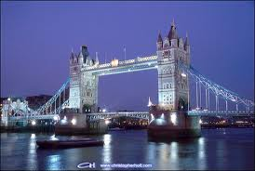
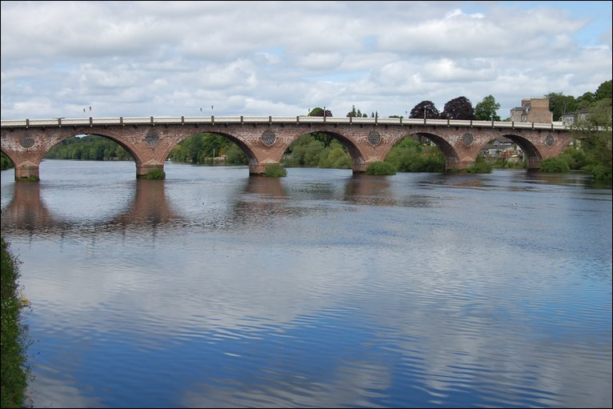
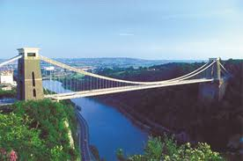
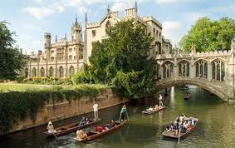
How many UK bridges can you identify? 100 pts for each
1 | 2
3 | 4

Slide 31
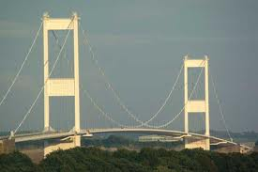
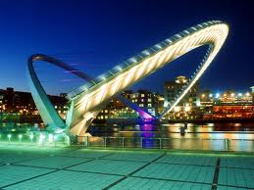
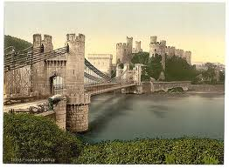
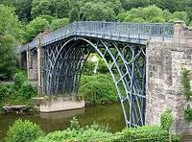
How many UK bridges can you identify? 100 pts for each
5 | 6
7 | 8

Slide 32
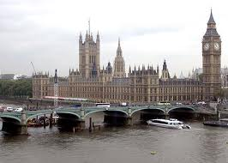
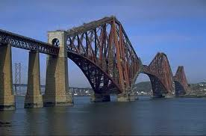
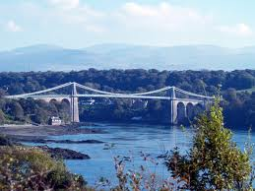
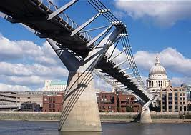
How many UK bridges can you identify? 100 pts for each
9 | 10
11 | 12

Slide 33
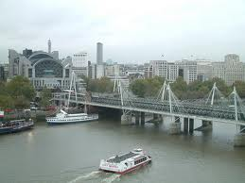
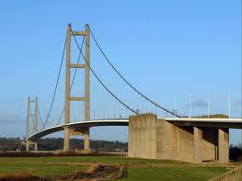
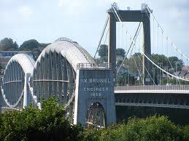
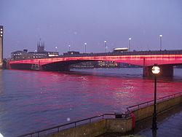
How many UK bridges can you identify? 100 pts for each
13 | 14
15 | 16

Slide 34
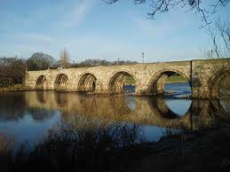
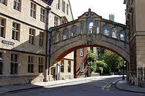
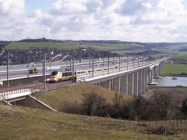
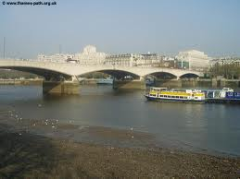
How many UK bridges can you identify? 100 pts for each
17 | 18
19 | 20

Slide 35
Answers
Have you made a note of all 20 answers?
The answers are on the next slide.

Slide 36
UK Bridges 100 pts for each
1 | Tower Bridge | 11 | Menai Bridge
2 | Perth Bridge | 12 | Millennium Bridge, London
3 | Clifton Suspension Bridge | 13 | Hungerford Bridge,London
4 | Bridge of Sighs, Cambridge | 14 | Humber Bridge
5 | Old Severn Bridge | 15 | Tamar Bridge, Plymouth
6 | Gateshead/Newcastle Millennium Bridge | 16 | London Bridge
7 | Conway Bridge | 17 | Aberdeen Bridge
8 | Ironbridge | 18 | Bridge of Sighs, Oxford
9 | Westminster Bridge | 19 | Medway Bridge
10 | Forth Bridge | 20 | Waterloo Bridge

Slide 37
Target
Did you manage more, or less, than 15?
What is your total number of points to date?
Have you met, or even surpassed, the target of 3300 points?

Slide 38
Target
In the next round there are 8 questions for you to gamble on. You can stake up to half the points you own at that point on each question. Once again you add, or subtract, the points depending on whether you get it right or not.
Your target at the end of this round is 6000 points.

Slide 39
Today an ounce of Gold costs £1056. What was the price in 1976?
A | £10
B | £20
C | £40
D | £60
E | £80

Slide 40
Today an ounce of Gold costs £1056. What was the price in 1976?
A | £10
B | £20
C | £40
D | £60
E | £80

Slide 41
How many Football League clubs have ‘CHEST’ within their name?
A | 2
B | 3
C | 4
D | 5
E | 6

Slide 42
How many Football League clubs have ‘CHEST’ within their name?
Manchester City, Manchester United, Colchester United, Chesterfield
A | 2
B | 3
C | 4
D | 5
E | 6

Slide 43
How many of these celebrities real names are correct? Elton John Reg Dwight Lulu Marie McDonald McLaughlin Lawrie Dolly Parton Dolly Parton Boy George George Alan O’Dowd David Bowie David Jones
A | 1
B | 2
C | 3
D | 4
E | 5

Slide 44
How many of these celebrities real names are correct? Elton John Reg Dwight Lulu Marie McDonald McLaughlin Lawrie Dolly Parton Dolly Parton Boy George George Alan O’Dowd David Bowie David Jones
A | 1
B | 2
C | 3
D | 4
E | 5

Slide 45
Which of these is not a city?
A | Cambridge
B | Carlisle
C | Chester
D | Chichester
E | Colchester

Slide 46
Which of these is not a city?
A | Cambridge
B | Carlisle
C | Chester
D | Chichester
E | Colchester

Slide 47
A Question of Sport? All of the 5 men shown below were, at one time, captains on the show. Which one was the third captain to take part?
A | Brendan Foster
B | Gareth Edwards
C | Cliff Morgan
D | Emlyn Hughes
E | Henry Cooper

Slide 48
A Question of Sport? All of the 5 men shown below were, at one time, captains on the show. Which one was the third captain to take part?
A | Brendan Foster
B | Gareth Edwards
C | Cliff Morgan
D | Emlyn Hughes
E | Henry Cooper

Slide 49
In 2010 the longest match ever held at Wimbledon took place between John Isner and Nicolas Mahut, with the score 6-4 3-6 6-7 7-6 70-68? How many ball changes were there?
A | 17
B | 18
C | 19
D | 20
E | 21

Slide 50
In 2010 the longest match ever held at Wimbledon took place between John Isner and Nicolas Mahut, with the score 6-4 3-6 6-7 7-6 70-68? How many ball changes were there?
A | 17
B | 18
C | 19
D | 20
E | 21

Slide 51
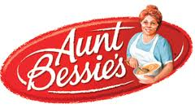
What was Aunt Bessie’s real name?
A | Bessie Oughtred
B | Bertha Oughtred
C | Bessie Jackson
D | Bertha Jackson
E | Did not really exist

Slide 52
What was Aunt Bessie’s real name?
A | Bessie Oughtred
B | Bertha Oughtred
C | Bessie Jackson
D | Bertha Jackson
E | Did not really exist

Slide 53
In 1934 the 57 Heinz varieties were listed? Which was not amongst them?
*************
A | Cooked Spaghetti
B | Cooked Macaroni
C | Sweet Mustard Pickle
D | Cucumber Pickle
E | Green Tomato Chutney

Slide 54
In 1934 the 57 Heinz varieties were listed? Which was not amongst them?
A | Cooked Spaghetti
B | Cooked Macaroni
C | Sweet Mustard Pickle
D | Cucumber Pickle
E | Green Tomato Chutney

Slide 55
Target
Your target was 6000 points. Did you meet, or even surpass, the target?
In the penultimate round you have to identify 20 birds which are, once again, in alphabetical order.
I think you will identify 15, giving you a total of 3000 points.
Therefore your overall target is 9000 points.

Slide 56
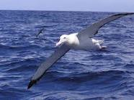
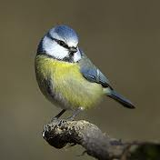
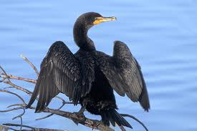
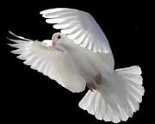
How many birds can you identify? 200 pts for each
1 | 2
3 | 4

Slide 57
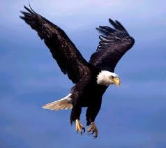
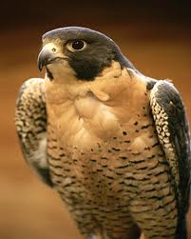
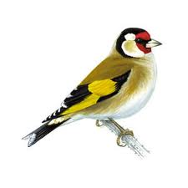
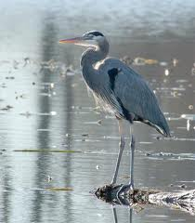
How many birds can you identify? 200 pts for each
5 | 6
7 | 8

Slide 58
How many birds can you identify? 200 pts for each
9 | 10
11 | 12

Slide 59
How many birds can you identify? 200 pts for each
13 | 14
15 | 16

Slide 60
How many birds can you identify? 200 pts for each
17 | 18
19 | 20

Slide 61
Answers
Have you made a note of all 20 answers?
Your target is to get at least 15 correct.

Slide 62
200 pts each
1 | Albatross | 11 | Lyrebird
2 | Bluetit | 12 | Magpie
3 | Cormorant | 13 | Nightingale
4 | Dove | 14 | Ostrich
5 | Eagle | 15 | Pheasant
6 | Falcon | 16 | Quail
7 | Goldfinch | 17 | Razorbill
8 | Heron | 18 | Tawny Owl
9 | Jay | 19 | Vulture
10 | Kingfisher | 20 | Wren

Slide 63
Target
Did you meet, or even surpass, the target of 3000 points on this round?
Are you meeting, or even surpassing, the overall target of 9000 points so far?

Slide 64
Final flourish
In the final furlong you have 10 further questions to gamble on.
The rules remain the same. You can stake up to half the points you own on each question, winning or losing that number of points depending whether you get the answer correct or not.
Your final target is 20,000 points

Slide 65
Today a pint of beer costs £2.20 in The Bull. What was the price in 1960?
A | 8p
B | 10p
C | 17p
D | 20p
E | 36p

Slide 66
Today a pint of beer costs £2.20 in The Bull. What was the price in 1960?
A | 8p
B | 10p
C | 17p
D | 20p
E | 36p

Slide 67
How many Football League clubs have ‘TON’ within their name?
A | 10
B | 11
C | 12
D | 13
E | 14

Slide 68
How many Football League clubs have ‘TON’ within their name?
Aston Villa, Charlton Athletic, Preston NE, Burton Albion, Leyton Orient,
Northampton Town, Southampton, Brighton & Hove Albion, Milton Keynes Dons, Everton, Wolverhampton Wanderers, Bolton Wanderers, Accrington Stanley
A | 10
B | 11
C | 12
D | 13
E | 14

Slide 69
How many of these celebrities real names are correct? Cilla Black Priscilla White Dusty Springfield Dusty Springfield Britney Spears Britney Spears Jimi Hendrix Johnny Hendrix Rod Stewart Roderick Stewart
A | 1
B | 2
C | 3
D | 4
E | 5

Slide 70
How many of these celebrities real names are correct? Cilla Black Priscilla White Dusty Springfield Dusty Springfield (Mary O’Brien) Britney Spears Britney Spears Jimi Hendrix Johnny Hendrix Rod Stewart Roderick Stewart
A | 1
B | 2
C | 3
D | 4
E | 5

Slide 71
Which of these is not a city?
A | Wakefield
B | Wells
C | Westminster
D | Wigan
E | Worcester

Slide 72
Which of these is not a city?
A | Wakefield
B | Wells
C | Westminster
D | Wigan
E | Worcester

Slide 73
In 1934 the 57 Heinz varieties were listed? Which was not amongst them?
A | Baked beans and pork sausage
B | Worcestershire sauce
C | Tomato Ketchup
D | Ripe Olives
E | Mayonnaise

Slide 74
In 1934 the 57 Heinz varieties were listed? Which was not amongst them?
A | Baked beans and pork sausage
B | Worcestershire sauce
C | Tomato Ketchup
D | Ripe Olives
E | Mayonnaise

Slide 75
Yorkshire or Lancashire?
Halifax (Yorkshire) Chorley (Lancashire)
Todmorden (Yorkshire) Keighley (Lancashire)
Pudsey (Yorkshire)
A | 1
B | 2
C | 3
D | 4
E | 5

Slide 76
Yorkshire or Lancashire?
Halifax (Yorkshire) Chorley (Lancashire)
Todmorden (Yorkshire) Keighley (Lancashire)
Pudsey (Yorkshire)
A | 1
B | 2
C | 3
D | 4
E | 5

Slide 77
Which of the 5 American cities has the largest population?
A | San Antonio
B | San Francisco
C | Las Vegas
D | Washington DC
E | Dallas

Slide 78
Which of the 5 American cities has the largest population?
A | San Antonio 1,330,000
B | San Francisco 805,000
C | Las Vegas 480,000
D | Washington DC 600,000
E | Dallas 1,200,000

Slide 79
What was Captain Birdseye’s real name?
A | Clarence Birdseye
B | Claude Birdseye
C | Captain Iglo
D | Clive Birdseye
E | Did not really exist

Slide 80
What was Captain Birdseye’s real name?
A | Clarence Birdseye
B | Claude Birdseye
C | Captain Iglo
D | Clive Birdseye
E | Did not really exist

Slide 81
Which of these 5 actors took part in the fewest Carry On films
A | Sid James
B | Hattie Jacques
C | Kenneth Williams
D | Barbara Windsor
E | Joan Sims

Slide 82
Which of these 5 actors took part in the fewest Carry On films
A | Sid James 19 films
B | Hattie Jacques 14 films
C | Kenneth Williams 26 films
D | Barbara Windsor 10 films
E | Joan Sims 24 films

Slide 83
Which one of the following has never been a full Olympic sport?
*************
A | Boules
B | Cricket
C | Croquet
D | Golf
E | Tug of War

Slide 84
Which one of the following has never been a full Olympic sport?
*************
A | Boules
B | Cricket 1900
C | Croquet 1900
D | Golf 1900-1904
E | Tug of War 1900-1920

Slide 85
Did you meet the target of 20,000 points?
That’s all folks

